Slide 1





AI for Data Engineering
Sean Wong
2025/01/01

Slide 2
CONTENTS
01
04
AI Fit Matrix
Docs & Reporting
02
05
Ingest & Clean
Vibe Hunting
03
06
Schema & Quality
Collaboration

Slide 3
CONTENTS
01
Governance
02
Next Steps

Slide 4

AI Fit Matrix
PART
01

Slide 5




Mapping Data Tasks to AI Upside
01
AI Suitability Matrix
02
High Potential Tasks
A matrix evaluates data engineering tasks against criteria like repetition, pattern density, and error risk to determine their suitability for AI automation or augmentation.
Tasks such as data ingestion, cleaning, and quality monitoring are highly suitable for AI due to their repetitive and pattern-heavy nature, offering significant automation benefits.

Slide 6




Criteria That Drive AI Adoption
01
03
Error-Prone Processes
Repetitive Tasks
Tasks that involve frequent repetition, such as data ingestion and transformation, are prime candidates for AI automation, reducing manual effort and increasing efficiency.
Tasks prone to human errors, such as data cleaning and quality monitoring, benefit from AI's ability to detect and correct inconsistencies, improving overall data quality.
02
Pattern Recognition
AI excels at recognizing patterns in data, making it ideal for tasks like anomaly detection and schema management, where pattern recognition is crucial.

Slide 7
Ingest & Clean
PART
02

Slide 8

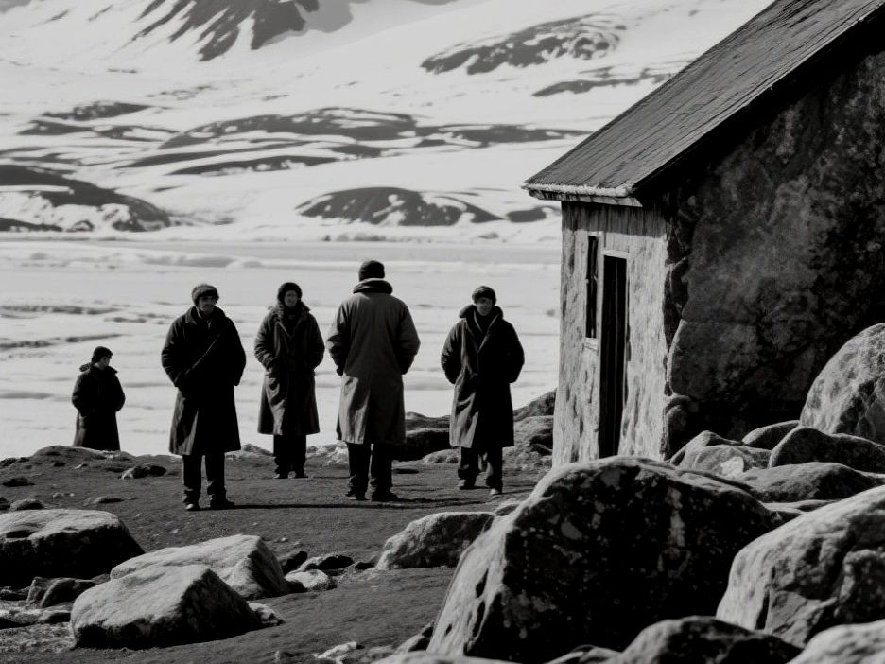

AI Auto-Ingests at Scale
Automated Data Ingestion
Tools like Fivetran and Matillion use AI to automate data ingestion, detecting schema changes and mapping data automatically, reducing manual effort and ensuring data consistency.

Slide 9


Smart Data Cleaning Workflows
01
AI-Driven Data Cleaning
Trifacta and DataRobot Paxata leverage AI to identify and correct data inconsistencies, missing values, and anomalies, significantly speeding up the data cleaning process.
Automated Transformations
AI tools suggest and apply data transformation rules, ensuring high-quality datasets for analytics and reducing the time spent on manual data wrangling.
02

Slide 10
Schema & Quality
PART
03

Slide 11



Schema Drift Detection AI
01
02
03
Version Management
Schema Management
Automated Schema Inference
Collibra and Alation use AI to detect schema drift and manage metadata, ensuring consistency and accuracy in data schemas.
AI tools like BigQuery AutoML automatically infer schemas for semi-structured data, simplifying the process of handling new data sources.
AI-driven tools manage schema versions and detect structural changes, providing real-time alerts and recommendations for seamless schema evolution.

Slide 12


Real-Time Anomaly Scoring
Anomaly Detection
Tools like Great Expectations AI and Datafold use AI to monitor data pipelines in real-time, detecting anomalies and flagging potential issues, reducing manual monitoring efforts.

Slide 13
Docs & Reporting
PART
04

Slide 14



Auto-Generate Pipeline Docs
01
Automated Documentation
DBT AI plugins and Alation generate data dictionaries, pipeline summaries, and transformation scripts, reducing the documentation burden on data engineers.
02
Data Lineage Tracking
AI-driven platforms like DataHub automatically track data lineage, providing transparent and auditable documentation for compliance and governance.

Slide 15


Compliance Reports on Demand
01
02
03
Audit Readiness
Compliance Reporting
Automated Reporting
Collibra AI generates compliance reports summarizing data quality scores, retention policies, and access controls, ensuring regulatory readiness.
AI tools schedule and generate quarterly reports, freeing engineers from manual documentation tasks and ensuring timely compliance.
Automated reports and lineage tracking ensure data engineers are always audit-ready, reducing the stress and effort associated with compliance checks.

Slide 16
Vibe Hunting
PART
05

Slide 17

DETAILS DE
AI-Guided Data Exploration
Interactive Exploration
OpenAI Codex for SQL and Trifacta AI enable interactive data exploration, suggesting queries and visualizations based on data patterns, accelerating feature engineering.

Slide 18

DETAILS DE
DETAILS DE
INFORMATI
AI-Driven Feature Engineering
01
AI tools recommend derived columns, encodings, and aggregation levels based on data analysis, improving model accuracy and reducing manual effort.
Rapid Feature Engineering
02
Iterative Prototyping
AI-driven exploration allows engineers to quickly prototype new data analysis and transformations, uncovering hidden patterns and insights.
INFORMATI

Slide 19
Collaboration
PART
06

Slide 20

Smart Knowledge Sharing
01
Knowledge Sharing
Slack AI bots post summaries of pipeline changes and quality anomalies to relevant channels, ensuring cross-team situational awareness.
02
AI-Driven Alerts
Monte Carlo AI generates concise change logs and lineage diagrams, helping downstream consumers understand impact and adjust dashboards quickly.
03
Collaborative Decision-Making
AI tools facilitate collaborative decision-making by providing real-time insights and recommendations, ensuring stakeholders are aligned.

Slide 21
AI-driven platforms automatically detect and alert teams to schema changes, quality issues, and other critical pipeline events, ensuring timely action.
AI-Driven Change Alerts
Automated Change Alerts

Slide 22
Governance
PART
07

Slide 23


01
Human Oversight
02
Accountability
Every AI-suggested change remains subject to engineer approval, ensuring domain context and ethical considerations override algorithmic recommendations.
Human oversight preserves accountability for critical data infrastructure decisions, ensuring compliance and reliability in production pipelines.
Human Oversight Mandate

Slide 24








Validate AI Recommendations
01
02
03
04

Slide 25
THANK
YOU
Sean Wong
22025/01/01

